Slide 1
Infographics

Slide 2
In today’s visual environment, people tend to be digital learners. An infographic makes complicated information and data easily understood and visually compelling!

Slide 3
What is and Infographic (interpreted with legos)

Slide 4
For this assignment, you will create an Infographic on a racial justice issue
experienced by Black persons in Canada.

Slide 5
Your research will give you insight into both the barriers and resilience of Black persons to the issues of racial justice experiences in Canada.

Slide 6
You will then share that information in the form of an infographic to make this information accessible

Slide 7
Let's look at the following infographics to develop ideas and determine the DO’S and DONT’S of creating infographics…
Notes:
Here you can co-create success criteria

Slide 8
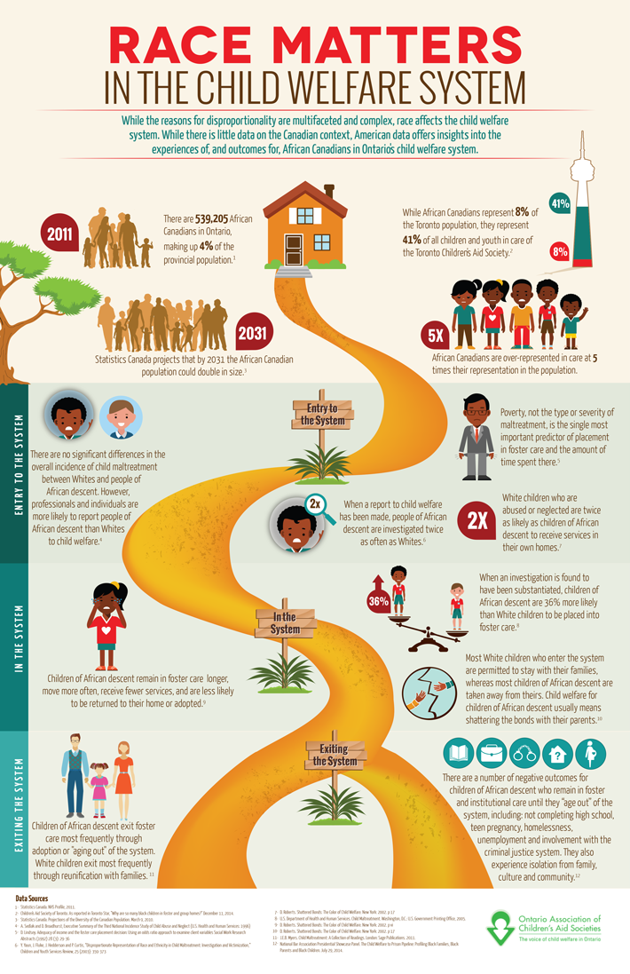
Race Matters in The Child Welfare System

Slide 9
Overrepresentation of Racialized Communities in the Justice System

Slide 10
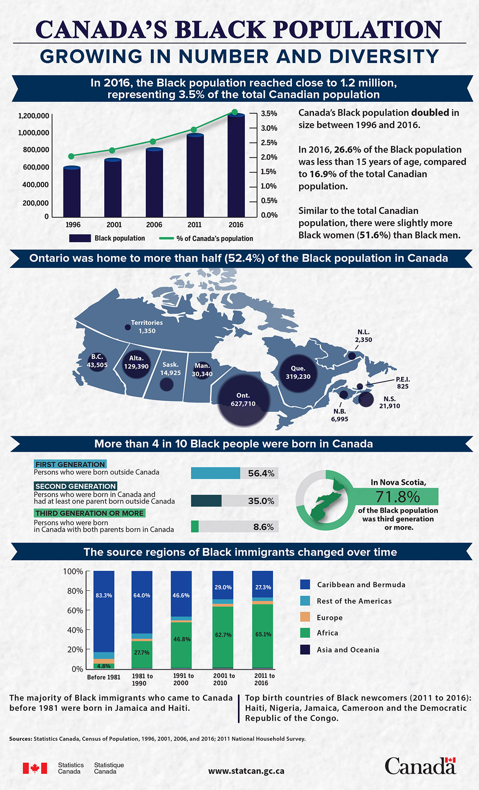
Canada’s Black Population growing in number and Diversity

Slide 11
https://www.homelesshub.ca/gallery/homeless-lgbtq2-youth-toronto
Homeless LGBTQ2 Youth in Toronto

Slide 12
https://www.toronto.ca/wp-content/uploads/2019/12/8638-HousingTO-Infographic_AODA.pdf
HousingTO 2020-2030 Action Plan

Slide 13
http://beta.legalaid.on.ca/strategic/wp-content/uploads/sites/4/2016/06/infographic-RCS-carding-2016-05-EN.pdf
RACIALIZATION OF CARDING AND STREET CHECKS

Slide 14
Osslt Results

Slide 15
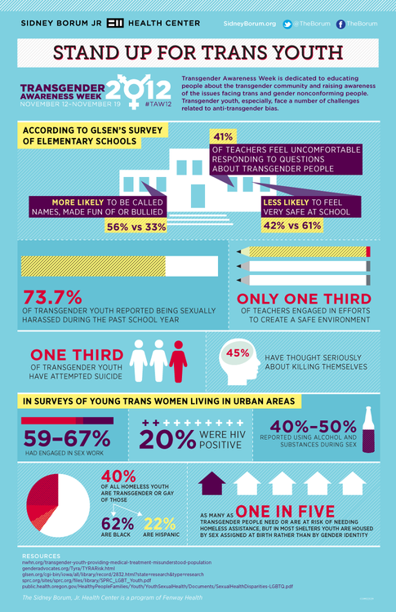
Stand up for Trans Youth

Slide 16
Accessible Canada Act

Slide 17
Monitoring the CRPD

Slide 18
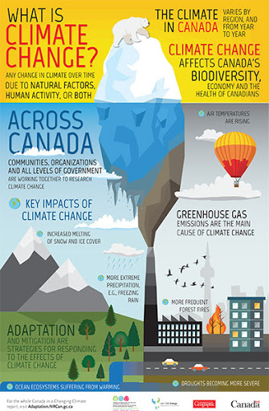
What is Climate Change

Slide 19
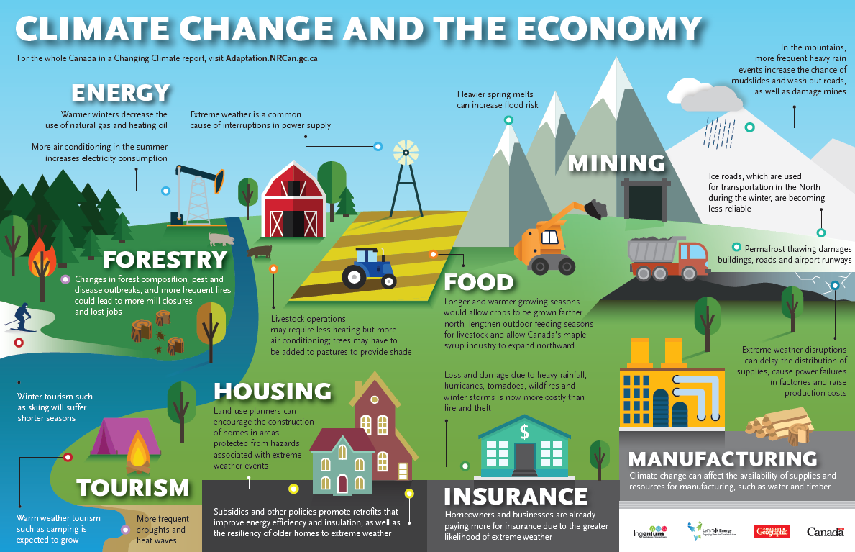
Climate Change and the Economy

Slide 20
Climate change

Slide 21
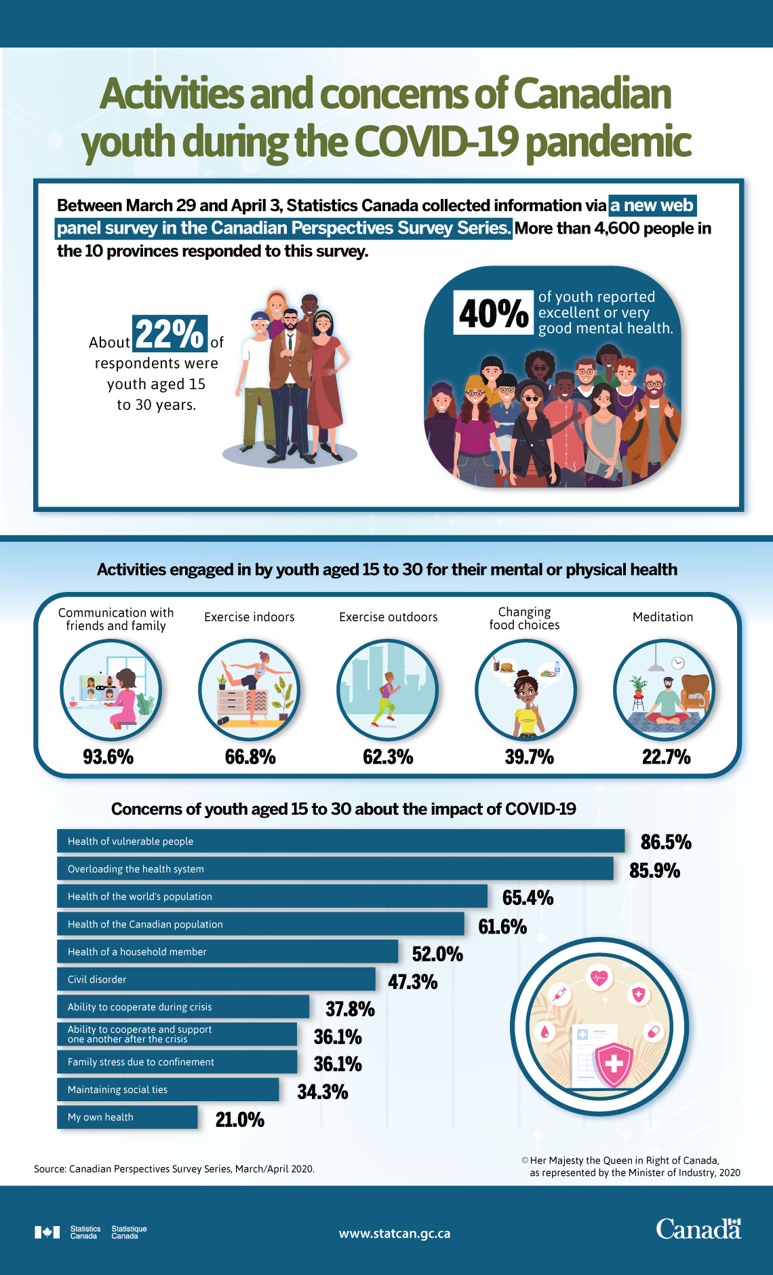
Youth Concerns During Covid-19

Slide 22
Are Children Getting Enough Sleep

Slide 23
Types of infographics
https://www.easel.ly/blog/types-of-infographics/

Slide 24
Resource List
Homeless Hub
Legal Aid Ontario
City of Toronto
Government of Canada

